Slide 1
High School presentation
Student Services

Slide 2
Schedule Changes
We are NOT changing electives or teachers.
We are only changing schedules for students that are...
missing a required course
already took the course

Slide 3
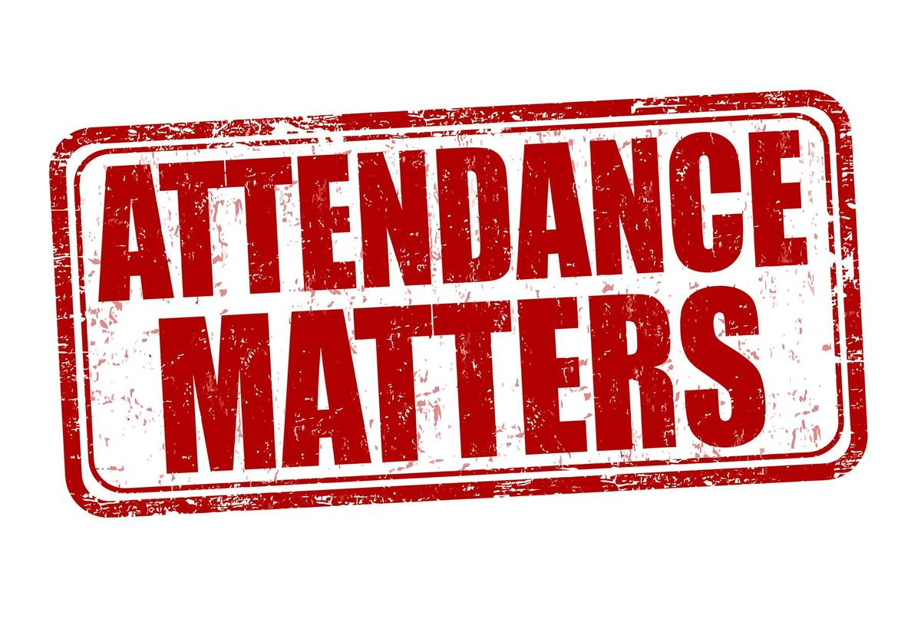
Attendance
10 unexcused absences within a 90-calendar period. The Truancy Process Begins...
Home visit by social worker, referral to The Parent Academy or Family Intervention.
Your Driver's License can be at risk of being suspended.
If you have a permit, missing school can prevent you from getting a Driver's License.

Slide 4
Attendance
You will have to repeat current grade level if you have...
More than 10 excused absences in a school calendar year
Tardiness
20 or more cumulative tardies, students will not be allowed to participate in the following...
Interscholastic competitions
Performances

Slide 5
Graduation Requirements

Slide 6
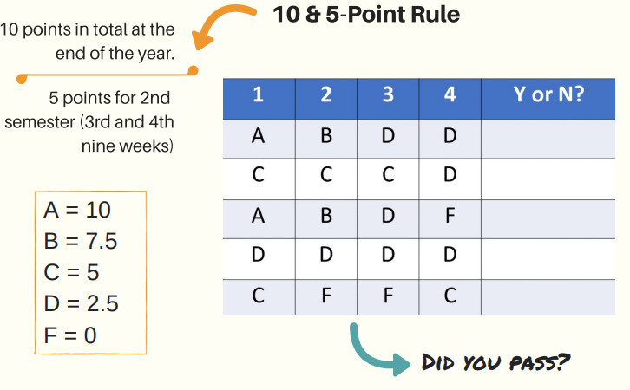
5-point rule

Slide 7
Career Shines

Slide 9
Florida Gold Seal
Vocational Scholars
Contact Information
Bright Futures (OSFA)
Number : 1-888-827-2004
Website : floridastudentfinancialaidsg.org
Email : osfa@fldoe.org

Slide 10
Dual Enrollment
Advantage on your college apps
Graduate with your AA before you graduate high school!!
You cannot have any C’s in your classes
Submit your course history prior to registering for any of your classes

Slide 11
College Corner

Slide 12
College corner

Slide 13
What is bullying?
Bullying is repetitive, aggressive behavior that is intentional and involves an imbalance of power and strength.
Bullying can take many forms such as: physical, verbal, cyberbullying, and nonverbal or emotional bullying.
Being bullied in school can affect student's engagement and learning in school.
Bullying can be a sign of other serious antisocial behavior.
Bullying creates a climate of fear and disrespect in schools and has a negative impact on student learning.

Slide 14
Bullying is Prohibited...
During any education program or activity conducted by Mater
During any school-related or school-sponsored program or activity
Through the use of any electronic device or data while on school grounds or on a school bus, computer software that is accessed through a computer, computer network of a school or M-DCPS.
This includes threats made outside of school hours, which are intended to be carried out during any school-related or school-sponsored program or activity, or on a school bus.

Slide 17
COUNSELING STAFF

Slide 19
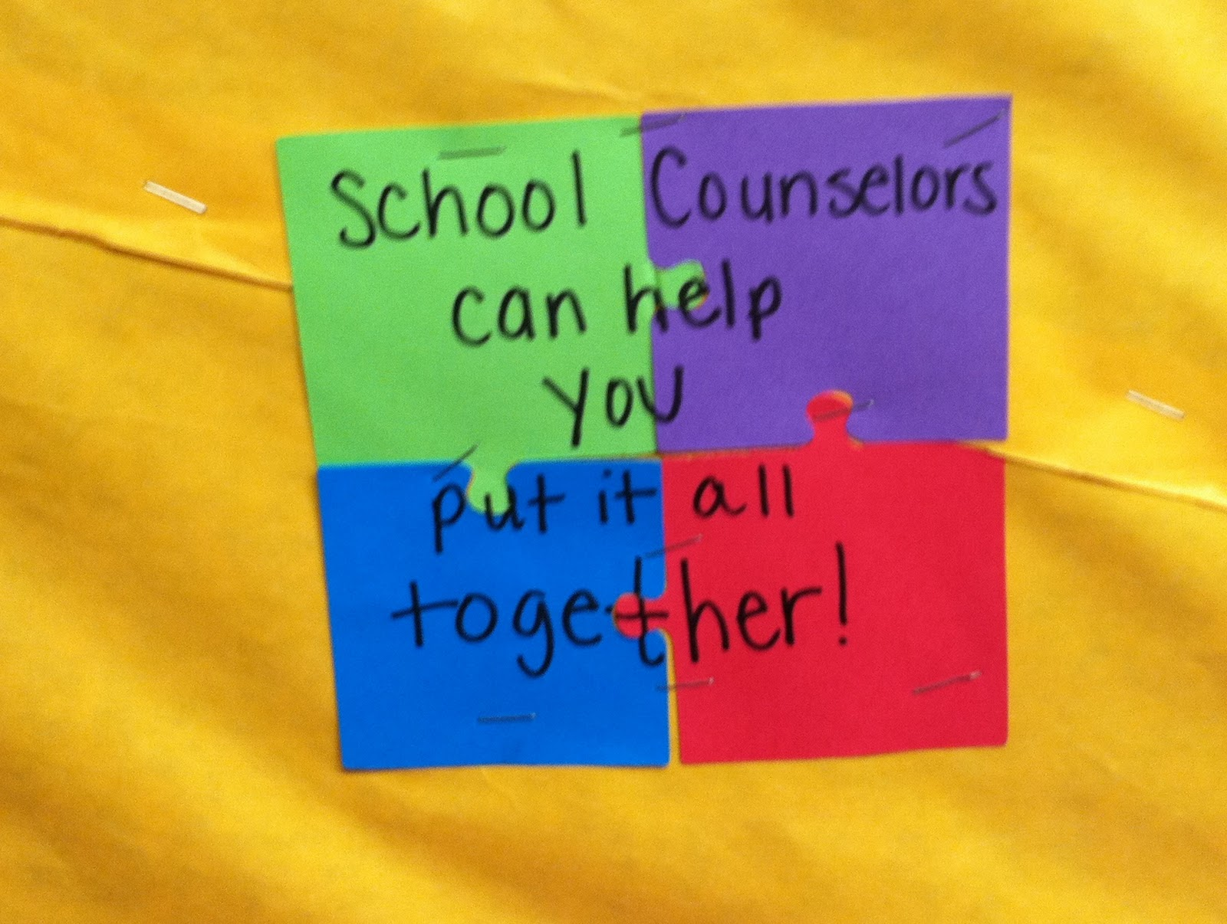
Contact us
CAP Advisor
Tere Olivert
Tolivert@materlakes.org
9th and 10th Grade Counselor
Patricia Bobea
pbobea@materlakes.org
11th and 12th Grade Counselor
Gilma Castillo
gcastillo@materlakes.org

